Slide 1


CENG 505
Parallel Computing I
Parallel Computing for Scheduling Algorithms
PREPARED BY:
  Atıl KURT
TO:
Cem ÖZDOĞAN
ATIL KURT

Slide 2
CENG 505
PARALLEL COMPUTING
OUTLINE
Introduction
Scheduling Problems
Optimum Algorithms
Heuristic algorithms
Scheduling for Parallel Processing
Conclusion
ATIL KURT

Slide 3
CENG 505
PARALLEL COMPUTING
INTRODUCTION
Scheduling : Establishing the timing of the use of equipment, facilities, and human activities
  Assignment
  Sequencing
Scheduling problems shown by α/β/γ symbols
  α: Machine environment
  β: Task system
  γ: Optimality criterion
ATIL KURT

Slide 4
CENG 505
PARALLEL COMPUTING
Scheduling Problems
α | β | γ
1 – Single machine P – Parallel machine Q – Uniform parallel machine R – Unrelated parallel machine F – Flow shop O – Open shop J – job sjop | Pmtn – Preemptive Chain – Precedence constraint NR – Non resumable rj – ready times Tool-change Eligibility Deterioting | Cmax – maximum completion time Lmax – maximum lateness ∑Cj – Total completion time ∑Tj – Total tardiness ∑uj – total tardy jobs ∑wjCj – Weighted completion times
R/tool-change,/Cmax : Makespan minimization problem on unrelated parallel machines with tool change constraints
ATIL KURT

Slide 5
CENG 505
PARALLEL COMPUTING
Optimum Algorithms
Optimum Special Algorithms
  Moore algorithm → 1//∑uj
  SPT → 1//∑Cj , P//∑Cj
  EDD → 1//Lmax
Mathematical model Solution tools
  Branch and Bound Algorithms
    Kouiki, S., Jemni, M. Ladhari, T., 2010, Design of parallel
    distributed algorithm for the permutation flow shop
Processor | 1 | 2 | 4 | 6
Tail092 | 2560 | 1400 | 750 | 560
Tail098 | 15050 | 6940 | 3860 | 2870
Run times (ms)
ATIL KURT

Slide 6
CENG 505
PARALLEL COMPUTING
Heuristic Algorithms
Special Heuristics
  LPT list algorithms → P//Cmax
  CDS heuristic → F//Cmax
Metaheuristics ←→ Local Search methods
  A top-level general strategy which guides other heuristics to search for feasible solutions in domains where the task is hard.
  Genetic Algorithm
  Simulated Annealing
  Tabu search
  Ant Colony optimiziation
ATIL KURT

Slide 7
CENG 505
PARALLEL COMPUTING
Heuristic Algorithms (cont’d)
Genetic algorithm
  Mimics the process of natural selection
  The Algorithms is generally as follows:
    Randomly generate an initial population M(0)
    Compute and save the fitness u(m) for each individual m in the current population M(t)
    Define selection probabilities p(m) for each individual m in M(t) so that p(m) is proportional to u(m)
    Generate M(t+1) by probabilistically selecting individuals from M(t) to produce offspring via genetic operators
    Repeat step 2 until satisfying solution is obtained.
ATIL KURT

Slide 8
CENG 505
PARALLEL COMPUTING
Heuristic Algorithms (cont’d)
Genetic algorithm (articles)
Wang, N.,(2004) A parallel computing application of the genetic algorithm for lubrication optimization. Tribology Letters, Vol. 18
Alba, E., Troye J. M., A survey of parallel distributed genetic algorithms
Bozejko, W. Wodecki, M., Parallel genetic algorithm for the flow shop scheduling problems
ATIL KURT

Slide 9
CENG 505
PARALLEL COMPUTING
Heuristic Algorithms (cont’d)
Simulated Annealing
  Analogy of solid thermodynamic state evaluation simulation
  Czech ,J.Z., Czarnas, P. Parallel simulated annealing for the vehicle routing problem with time windows
  Barry, D. A., Morris, J., Parallel simulated annealing using CILK language: Aplication in estimating transport parameters for groundwater contaminants
ATIL KURT

Slide 10
CENG 505
PARALLEL COMPUTING
Heuristic Algorithms (cont’d)
Tabu Search
  Uses a strategy of proccessing in the direction of biggest decrease or the smallest increase, of the objective function.
  Gendreau, M., laporte, G., Semet, F. (2000). A dynamic model and parallel tabu search heuristic for real-time ambulance relocation.
  Yi, H.,Yuhui, Q., Guangyuan, L., Kaiyou, L.,(2003). A parallel tabu search approach based on genetic crossover operation.
  Craınıc, T. G., Gendreau M., Potvin ,J., Parallel tabu search
ATIL KURT

Slide 11
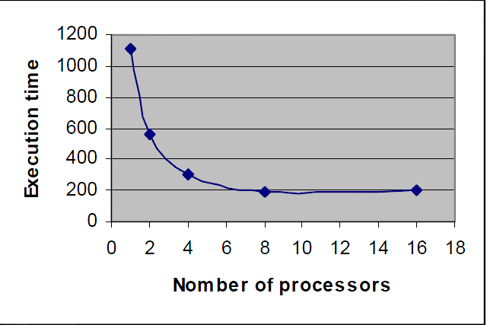
CENG 505
PARALLEL COMPUTING
Heuristic Algorithms (cont’d)
Ant Colony optimization
  Seeks to mimic an ant's apparent ability to find the shortest distance between two points.
  Randall, M., A parallel implementation of Ant Colony Optimization.
  Delisle, P., Krajecki, M., Gravel, M., Gagné, C., Parallel implementation of an Ant Colony Optimization metaheurıstıc with OPENMP.
Number of Processors
ATIL KURT

Slide 12
CENG 505
PARALLEL COMPUTING
Scheduling for Parallel Processing
Scheduling algorithm can be used for the Parallel Processing
Reduction in CPU with load balancing
Use
Processors → Machine
Task → Job
CPU of Task → Processing times
Processor are identical : Processor load balancing → P//Cmax
Processor are not identical : Processor load balancing → R//Cmax
ATIL KURT

Slide 13
CENG 505
PARALLEL COMPUTING
Conclusion
Parallel Algorithms are applicable for Scheduling Problems
These algorithms have a lots of application in literature
These algorithms give good solution for the NP-hard scheduling algorithms
These Algorithms can be used for my thesis.
  B & B algorithm
  Metaheuristics
ATIL KURT

Slide 14
CENG 505
PARALLEL COMPUTING
THANKS !!!
FOR YOUR LISTENING
ATIL KURT

