Slide 1
Design Patterns for Parallel Programming
Çağlar GÜNEL
200871202

Slide 2
Overview
Introduction to Design Patterns
Pattern Languages
4 Design Spaces
Example: Data Decomposition Pattern
Q&A

Slide 3
What is a Design Pattern?
A design pattern describes
a good solution
to a recurring problem
in a particular context.

Slide 4
Why Design Patterns?
The aim is to
record the experience of
experts in a way that can be
used by others facing a similar problem.
They
Provide a cookbook to systematically guide programmers
Provide common vocabulary to the programming community

Slide 5
Design Patterns for Parallel Programming
Most parallel software design problems are very complex that designers cannot initially see the solution.
To produce a parallel program, designers should work systematically and need to proceed step-by-step.

Slide 6
What is a Pattern Language?
A pattern language is something more than a catalog of patterns.
In a pattern language, the patterns are organized into a structure that leads the user through the collection of patterns.

Slide 7
Why Pattern Language?
At each decision point, the designer selects an appropriate pattern. Each pattern leads to other patterns, resulting in a final design.
A pattern language embodies a design methodology and provides domain-specific advice to the application designer.
This guides a developer in the process of developing a parallel program.

Slide 8
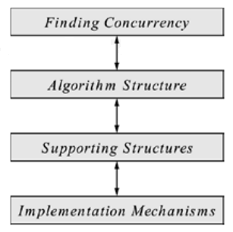
Overview of the Pattern Language
The pattern language is organized into four design spaces:
Patterns for Parallel Programming, T.G. Mattson, et.al., 2004

Slide 9
Finding Concurrency DS
Helps to structure the problem to expose exploitable concurrency.
The designer working at this level focuses on high-level algorithmic issues and tries to expose potential concurrency.

Slide 10
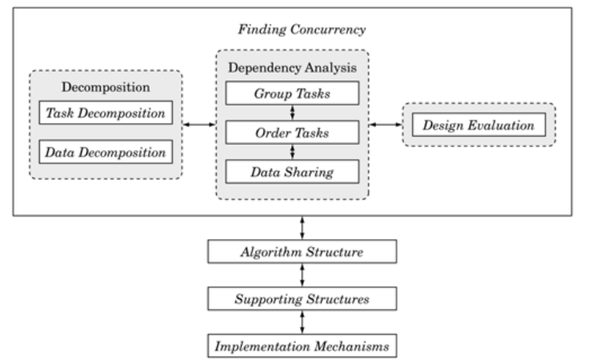
Finding Concurrency DS

Slide 11
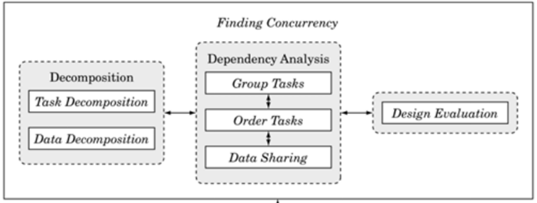
Decomposition Patterns
Used to decompose the problem into pieces that can execute concurrently.

Slide 12
Decomposition Patterns
The first step in designing a parallel algorithm is to decompose the problem into elements that can execute concurrently.
The task-decomposition dimension views the problem as a stream of instructions that can be broken into sequences called tasks that can execute simultaneously.
Should be used when tasks are largely independent of each other
The data-decomposition dimension focuses on the data required by the tasks and how it can be decomposed into distinct chunks.
Should be used when the data chunks can be operated upon relatively independently.

Slide 13
Data Decomposition Pattern
Problem: How can a problem's data be decomposed into units that can be operated on relatively independently?

Slide 14
Data Decomposition Pattern
Context: A data-based decomposition is a good starting point if the following is true:
The most computationally intensive part of the problem is organized around the manipulation of a large data structure.
Similar operations are being applied to different parts of the data structure, in such a way that the different parts can be operated on relatively independently.
For example, many linear algebra problems update large matrices, applying a similar set of operations to each element of the matrix.

Slide 15
Data Decomposition Pattern
Solution: A few common examples include the following:
Array-based computations: Concurrency can be defined in terms of updates of different segments of the array.
Recursive data structures: We can think of, for example, decomposing the parallel update of a large tree data structure by decomposing the data structure into sub trees that can be updated concurrently.

Slide 16
Dependency Analysis Patterns
Helps to group the tasks and analyze the dependencies among them.

Slide 17
Design Evaluation Pattern
Guides the algorithm designer through an analysis of what has been done so far before moving on. Best design is not found on the first attempt.

Slide 18
Algorithm Structure DS
Helps to structure the algorithm to take advantage of potential concurrency.
Describes overall strategies for exploiting concurrency.
Refines the design and
Moves it closer to a program that can execute tasks concurrently by mapping the concurrency onto multiple UEs.

Slide 19
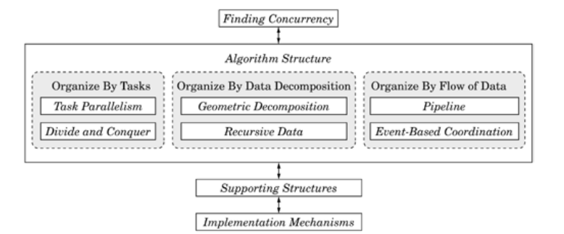
Algorithm Structure DS

Slide 20
Supporting Structures DS
Represents an intermediate stage between the Algorithm Structure and Implementation Mechanisms design spaces.
Two important groups of patterns in this space are those that represent
program-structuring approaches and
those that represent commonly used shared data structures.

Slide 21
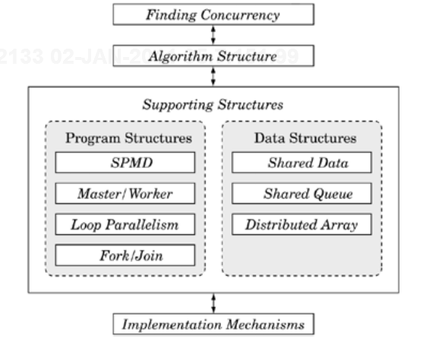
Supporting Structures DS

Slide 22
Implementation Mechanisms DS
Concerned with how the patterns of the higher-level spaces are mapped into particular programming environments.
Provides descriptions of common mechanisms for
process/thread management (i.e., creating or destroying)
and process/thread interaction (i.e., semaphores, barriers, or message passing).
The items in this design space are not presented as patterns because they map directly onto elements within particular parallel programming environments.
They are included in the pattern language to provide a complete path from problem description to code.

Slide 23
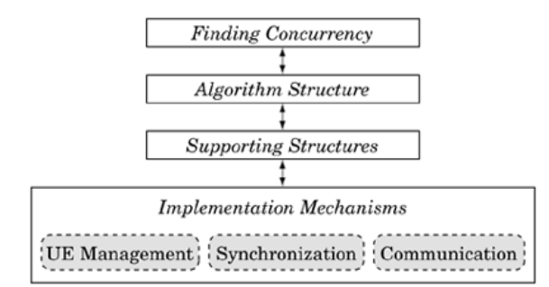
Implementation Mechanisms DS

Slide 24
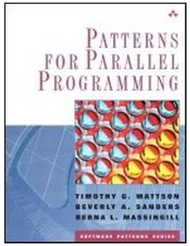
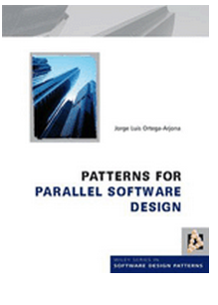
Q&A
ISBN: 978-0-321-22811-6
ISBN: 978-0-470-69734-4

Slide 25
Thank you…

