Slide 1
Message passing in java
FIRAT AKBA
200611003

Slide 2
INTRODUCTION
MPI is the standard message passing API for parallel computing.
As Java started becoming popular there was immediate interest in exploring its possible uses for parallel computing.
The performance of Java implementations is much slower than standard MPI implementations.
Programming models can be categorized into two based on how memory is used.
-Shared Memory
-Message Passing(MPI)
The MPI standard defines a set of functions that support Point-to-Point Communication

Slide 3
Java for Message Passing Model
Java is not so popular in scientific and parallel community because of two main reasons
- Numerical problems, such as precision error, floating point reproducibility problem etc.
-Poor performance of Java compared to C or C++.
Single-JVM Programming Models
From JDK 1.5 there is a mechanism in Java called CyclicBarrier that allows a set of threads to all wait for each other to reach a common barrier point. The Executor Framework can be used to maintain a thread pool and distribute the task to multiple threads.

Slide 4
Multi-JVM Programming Models
Java Native Interface (JNI) to use the existing standard MPI implementations in C or Fortran
Use core Java API such as java.net, java.io and java.nio libraries as underlying communication layer.

Slide 5
Java Native Interface (JNI)
Java Native Interface (JNI) is a mechanism built into the JVM so as to invoke local system calls to perform input and output, graphics, networking, and threading operations on the host operating system.
JNI can be used to provide wrappers for native MPI implementations, thereby enabling Java processes in different JVM to communicate with each other.
In a JNI implementation it is not possible to use MPI operations to communicate between Java threads because it is not safe to run more than one thread in a single JVM to perform MPI operation. This is because native implementations of MPI might not be thread-safe.

Slide 6
java.nio library is its ability to operate in non-blocking mode .
Buffers provide a mechanism to store a set of primitive data elements in an in-memory container.
«mpiJava» is the most active Java wrapper project, provides an object oriented interface to standard MPI called MPJ. It consists of a collection of wrapper classes with C++ like interface that call a native MPI implementation through JNI.

Slide 7
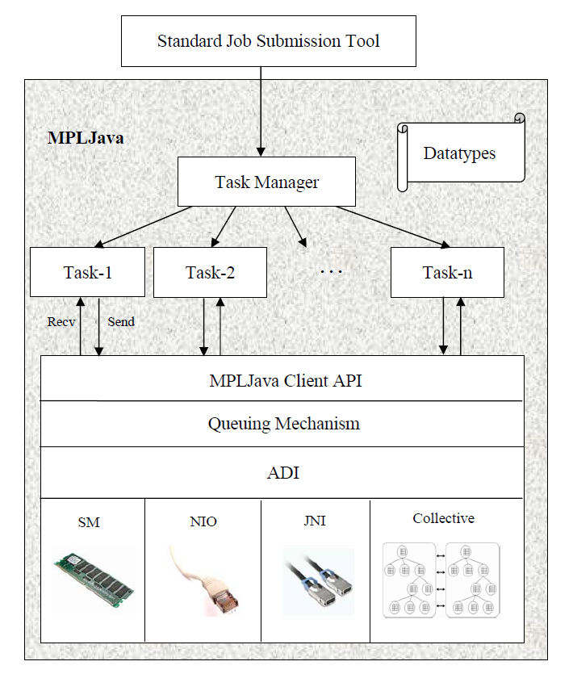
System Architecture (MPL in Java)

Slide 8
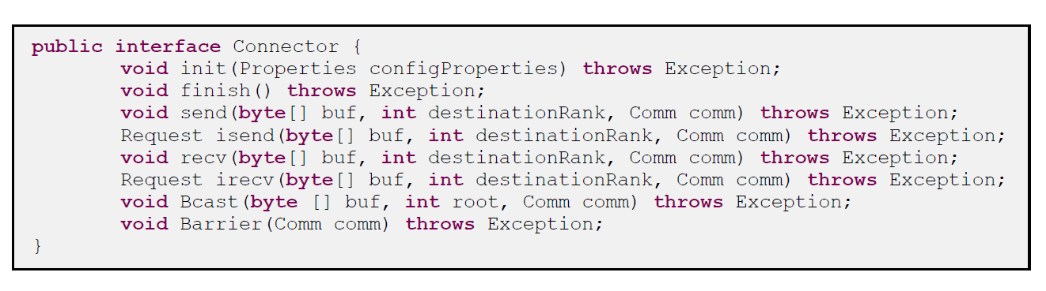
System Architecture (MPL in Java)
The initial set of APIs consists of MPI.send and MPI.recv for blocking communication, MPI.isend and MPI.irecv for non-blocking communication, Comm.getMpiCommWorld, Comm.getRank and Comm.getSize to retrieve the basic set of parameters of a MPI task, Request.iwait for a task to wait for non-blocking communication to complete
Example:

Slide 9
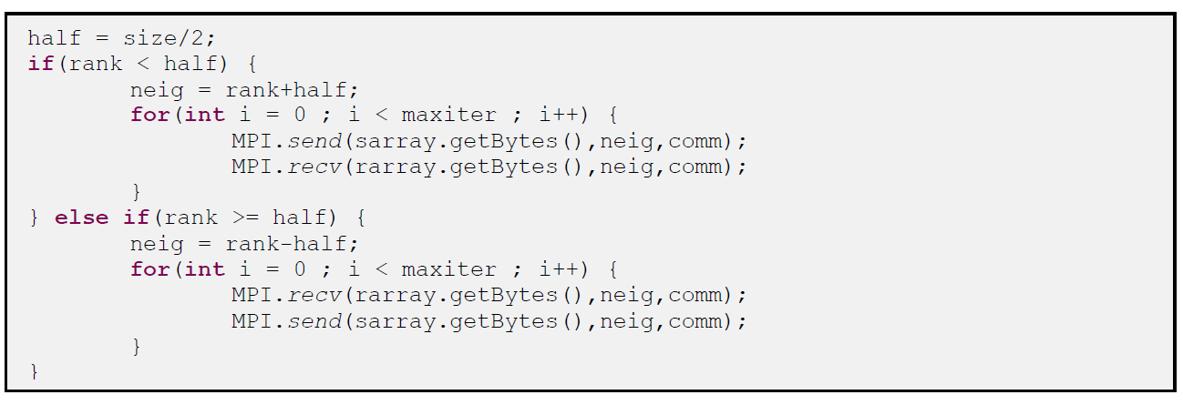
System Architecture (MPL in Java)

Slide 10
System Architecture (MPL in Java)
import mpi.*
class Hello {
static public void main(String[] args) {
MPI.Init(args) ;
int myrank = MPI.COMM_WORLD.Rank() ;
if(myrank == 0) {
char[] message = “Hello, there”.toCharArray() ;
MPI.COMM_WORLD.Send(message, 0, message.length, MPI.CHAR, 1, 99) ;
}
else {
char[] message = new char [20] ;
MPI.COMM_WORLD.Recv(message, 0, 20, MPI.CHAR, 0, 99) ;
System.out.println(“received:” + new String(message) + “:”) ;
}
MPI.Finalize() ;
}
}

Slide 11
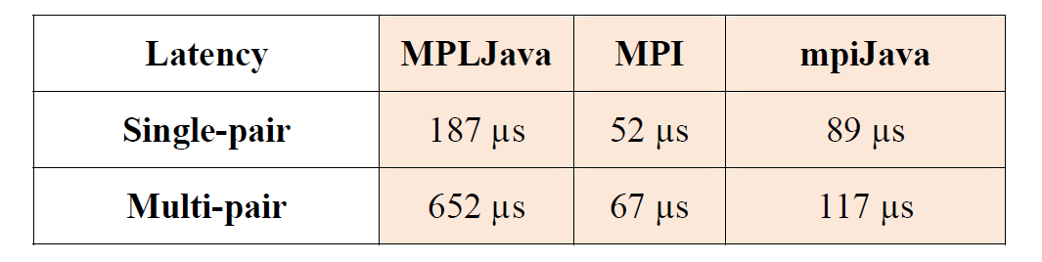
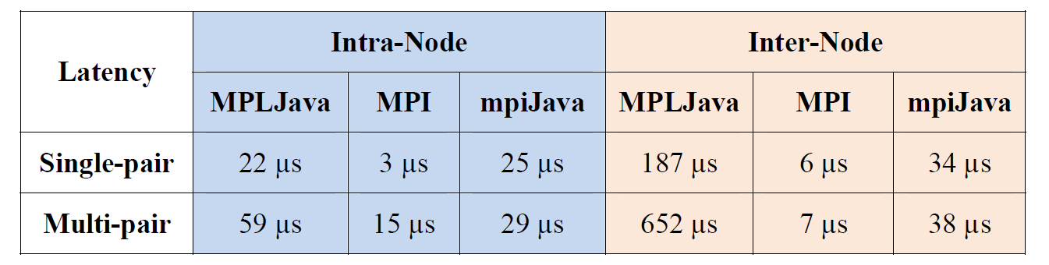
Performance Comparings

Slide 12
Thanks For listening...

