Slide 1
Storage Area Network
MURAT ALTUN
200871207

Slide 2
Summary
BEFORE SAN
What is a SAN
Basic Building Blocks of a SAN
A zoom into the Storage Architectures
SAN elements and architecture
Basic Protocols and Mechanisms
Who is who: Standardization Bodies and Industry Organizations

Slide 3
Summary
BEFORE SAN
What is a SAN
Basic Building Blocks of a SAN
A zoom into the Storage Architectures
SAN elements and architecture
Basic Protocols and Mechanisms
Who is who: Standardization Bodies and Industry Organizations

Slide 4
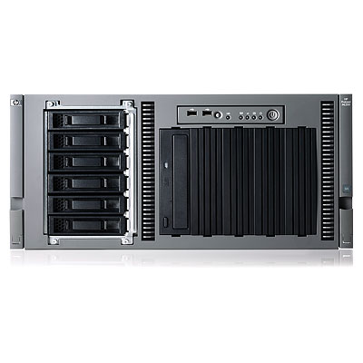
SIMPLE SERVER
 | Before SAN disks stored on the server and can only be reached and manageg by that server only

Slide 5
Summary
BEFORE SAN
What is a SAN
Basic Building Blocks of a SAN
A zoom into the Storage Architectures
SAN elements and architecture
Basic Protocols and Mechanisms
Who is who: Standardization Bodies and Industry Organizations

Slide 6
Definition
A SAN (Storage Area Network) is a network designed to transfer data from servers to targets, and it is alternative to a directly attached target architecture, or to a DAS architecture, where the storage is connected to the servers on general purpose networks
Additional definitions of a SAN imply that the SAN should also be highly performing, and should be such to enable storage devices to communicate with one another and with computer systems

Slide 7
Different technologies
Multiple technology can be used when building a SAN; traditionally the dominant technology is Fiber Channel, but IP based solutions are also quite popular for specific applications
The concept of SAN is also independent from the devices that are attached to it. Can be disks, tapes, RAIDs, file servers, or other

Slide 8
SAN and NAS: network and node
SAN vs NAS: while a SAN is a network connecting storage subsystems, the NAS is a storage subsystem, making use of a general purpose network.
The SAN is an extension of the disk channel outside the server, while the NAS is a disk subsystem connected to the servers, in most cases via an IP network.

Slide 9
Summary
What is a SAN
Basic Building Blocks of SAN
A zoom into the Storage Architectures
SAN elements and architecture
Basic Protocols and Mechanisms
Who is who: Standardization Bodies and Industry Organizations

Slide 10
SAN interconnections
As said, different technologies can be used to interconnect the network nodes, extending the Disk interface outside the server
Fiber Channel is a dedicated channel based high performance and highly available network based on Fiber Channel Protocols
iSCSI is SCSI protocol carried over an IP network. In this case the network infrastructure can be shared with other applications
SCSI network is an extension of the internal SCSI bus, used for short distances due to its parallel architecture

Slide 11
Initiator and Target in FC SANs
Fiber Channel Node: can be the source or the destination of information
If the node is an Initiator (source), it is usually connected to the network via an HBA (Host Bus Adaptor), which is the physical connection interface, and can be based either on electrical or (more often) optical technology
If the node is a target (destination), it can be a JBOD (Just a Bunch of Disks), a RAID (Redundant Array of Independent Disks), or a Storage array

Slide 12
Hard Drives
The basic storage element is an Hard Drive. They are made into complex devices composed of platters, heads, cylinders and tracks
The Logical Block Addressing (LBA) addresses the sector within the disk. Modern drives have 512 byte sectors
File systems arrange files into sectors so that they can be stored and retrieved
The File system usually deals with clusters of blocks and uses a FAT (File Allocation Table) to map a file to the sectors

Slide 13

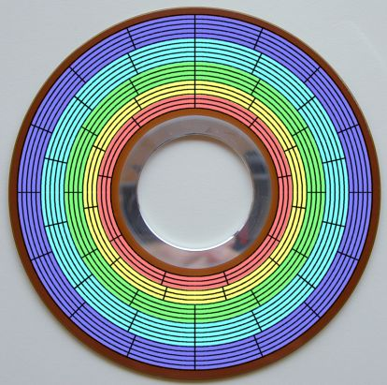
FAT
…
…
File Allocation Table

Slide 14
JBODs and RAIDs
While a Jbod is a group of disks packaged in an enclosure and connected via a FC loop, a RAID is a more sophisticated device, that may improve performance and/or reliability of the storage device
RAID is improving performances reading/writing information from a set of disks at the same time, and reliability adding parity and/or mirroring information on multiple disks of the array
RAID can be performed in HW via a controller embedded in the enclosure or software on the host

Slide 15
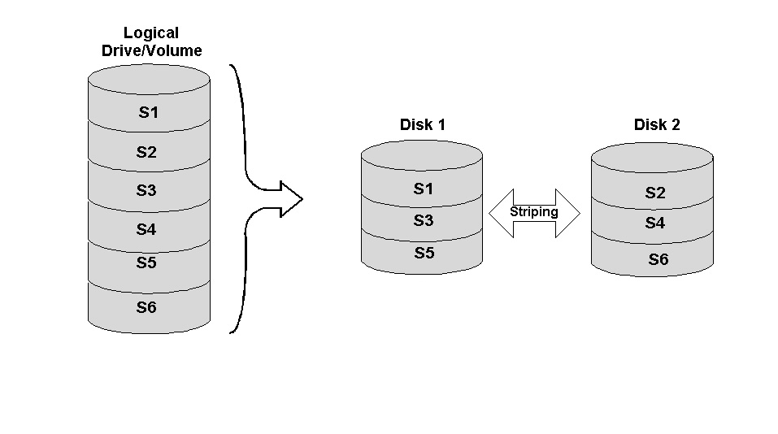
RAID 0 or striping
Data are split onto different disks for performance increase: performances depend on information unit size vs stripe size
No redundancy added
Cost is limited (no additional hardware)

Slide 16
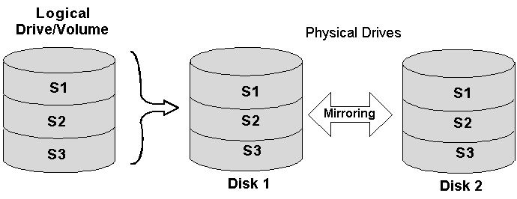
RAID 1 - mirroring
Data are replicated on multiple disks for redundancy
Performance may be impacted if copy is done serially
Increase of cost proportional to the amount of redundancy
More complex algorithm to manage multiple copies

Slide 17
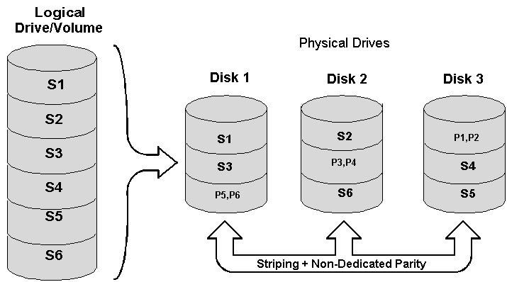
RAID 3
Data protection via ECC (Error Correction Control code)
Good redundancy
Performance not changed for reads but lower for writes since the ECC need to be calculated
Cost is only 1 extra disk for the entire logical array

Slide 18
RAID 5
Data protection with ECC, but parity is spread on the array
Good redundancy
Same speed reads, slower writes
One disk per array of added cost

Slide 19
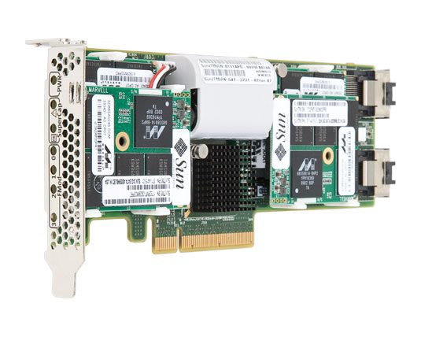
SSD FLUSH CARD

Slide 20
Summary
What is a SAN
Basic Building Blocks of a SAN
A zoom into the Storage Architectures
SAN elements and architecture
Basic Protocols and Mechanisms
Who is who: Standardization Bodies and Industry Organizations

Slide 21
RAID array vs DAS vs NAS vs SAN (I)
A RAID array is an enclosure containing a set of disks and a RAID controller providing in hardware the features of a RAID 0 – 5 and usually some caching engine
A DAS (Direct Attached Storage) is an architecture for which the storage is “privately” attached to the servers: cannot be shared, it is hard to scale, expensive and complex to manage. 80% of the market it is still DAS

Slide 22
RAID array vs DAS vs NAS vs SAN (II)
NAS (Netwrok Attached Storage) is an architecture for which the storage is attached to the servers via a multi-purpose network, and it is accessed at a file level via protocols like CIFS or NFS
The network is usually an IP network
TCP can be tuned to optimize storage transport

Slide 23
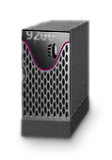
DAS vs NAS architecture
Clients
LAN
Application
Servers
LAN
Win2k
Linux
Unix
Win2k
Linux
Unix
Win2k
Linux
Unix
Generic
Generic
SCSI
FC
FC
Application
Servers
NAS Appliances
or
NAS Head Ends
Tape
Direct Attached
Storage

Slide 24
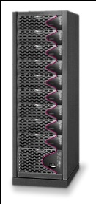
SAN architecture
Storage is accessed at block level not at file level
Very high performances
Storage is shared
Good management tools
Interoperability issues
Clients
LAN
Database
Servers
Fibre Channel SAN
Block
Storage
Devices
Storage Area Network (SAN)

Slide 25
Summary
What is a SAN
Basic Building Blocks of a SAN
A zoom into the Storage Architectures
SAN elements and architecture
Basic Protocols and Mechanisms
Who is who: Standardization Bodies and Industry Organizations

Slide 26
SAN
SAN is the convergence of an almost-error-free, very reliable interface and the advantage of a networking infrastructure
It takes advantage of a controlled and reliable data transfer interface and adds the capability of switching and sharing proper of the networks
Relies on at least 10 to -12 error probability infrastructure

Slide 27
SAN basic requirements
The concept of SAN is to bring a block level interface on a very reliable support, and add the advantages of a networking infrastructure
Need to be scalable in terms of speed, fast and efficient getting rid of all the low level error recovery mechanisms: will treat the errors as exceptions at application or firmward level
Allow extensions like long distance, multi protocol support (SCSI, ESCON, TCP/IP..), rely on great simple connectivity

Slide 28
SAN supported topologies: point to point
Point to point is the simplest topology for very limited connectivity needs
It guarantees in order delivery and full bandwidth access
The application can handle any multipath connectivity to a set of disks in case this is provided, since no other elements are present in this topology
TX
TX
RX
RX

Slide 29
SAN supported topologies: arbitrated loop
Designed to scale to a limited number of nodes (up to 127)
Low cost (no interconnecting devices needed)
Arbitration protocol is designed to manage media sharing across nodes; may be disruptive when a node gets added/removed from loop and loop initialization protocol kicks in
A arbitrating hub can be used instead of a distributed protocol
Each node can be
a server or a storage device

Slide 30
SAN supported topologies: switched fabric
In a switched fabric topology, switching element get added to the nodes to allow interconnections via point-to-point links
Extended number of devices (potentially thousands) and greater distances can be achieved
Scalable, robust and reliable architecture, but the cost of the interconnection devices adds on
Fibre Channel SAN
Block
Storage
Devices
Switched Topology

Slide 31
Summary
What is a SAN
Basic Building Blocks of a SAN
A zoom into the Storage Architectures
SAN elements and architecture
Basic Protocols and Mechanisms
Who is who: Standardization Bodies and Industry Organizations

Slide 32
Fiber Channel and the others
Fiber Channel and SCSI: they are not alternatives: FC will act as a transport layer for SCSI, amongst other protocols
Fiber Channel and IP: sometimes that are alternatives, sometimes not. While FC is used instead of a TCP/IP network to connect reliable the servers to the storage, IP can still be used to extend FC networks over long geographical distance; in turn in some applications, FC can be used to carry IP traffic (mostly for in-band management)

Slide 33
FC protocols and services
FC offers a layer 2 transport service, and uses layer 3 services to provide it, and to map upper layer protocols like SCSI, HIPPI, IP or others
FC0 defines the physical interface (data rates, connectors, media, distances, power and so on
FC1 deals with encoding/decoding of bits on the physical interface and low level signalling
FC2 defines framing and classes of services
FC3 provides common services like multicasting or possibly encryption
FC4 maps upper layer protocols onto Fiber Channel
FC-0 to 2 are the core of the FC link protocol, and will be examined in more detail in the next set of slides

Slide 34
FC0: physical interface
FC supports many different variations of physical interfaces: Electrical and Optical both Multi Mode and Single Mode. They vary in terms of cost and performances (distance and speed)
The basic physical access to a FC port is so called GBIC (Gigabit Interface Connector) which is a hot swappable connector supporting all types of media, and comes in different form factors. The MIA (Media Interface Adaptor) is an electrical DB-9 to optical interface converter, that can be applied externally to the enclosure (disk or host)
Fiber channel connections are always bi-directional, point to point, serial. No drops or taps are considered in FC
All links should be capable of BER (Bit Error Rate) of 10 to -12 or less

Slide 35
FC-1: Line encoding
FC-1 is in charge of bit transmission on the line. Since FC uses a serial transmission, an encoding in needed in order to transmit the clock signal along with the data. This is achieved mapping any pattern of 8 bits into a 10 bit pattern that will guarantee enough signal transitions, and so enough clock signal power on the line. The clock signal is filtered and recovered at the receiving point, and the bits are decoded
Not all the possible 10 bits sequences are used: only the ones that guarantee enough transitions are allowed. The others are invalid chars. Each 8 bits char has 2 coding on 2 10 bit patterns with opposite disparity (numbers of 0s and 1s), or 1 coding if the 10 bit pattern has no disparity (Same number of 0s and 1s)
To avoid accumulation of DC at the receiver, the encoder remembers every time it has transmitted a char with disparity (different numbers of ones and zeros) and will send the next char coded with opposite disparity. This mechanism is called running disparity

Slide 36
FC-1 characters
FC is a word oriented architecture: 4 characters form a word
All possible 256 chars are mapped into 10 bit strings, and further 10 bits strings are available outside the coding space. Those are called special characters.
The encoder can encode data char as well as data char, and an input signal to the encoder will signal the encoder itself if the coming pattern is data or special char (K/D)

Slide 37
FC-1: Transmission words and Ordered sets
The transmitted words are composed by a sequence of 4 characters.
The first character of the sequence will tell if the remaining three need to be interpreted as control signals or data. If it is a K28.5 then the next 3 char are to be considered signals, and the word is called ordered set
The ordered set are divided into Primitive Signals (fill words and non-fill words), Frame delimiters (SOF and EOF) and Primitive Seqiences (if they are repeated multiple time on the line like NOS, OLS, LR, LRR, LIP, LPB, LPE)

Slide 38
FC-2: the frames
Before any data is echanged, a session need to be established between the end ports, FC-2 is in charge of login session
Once the link is established, FC-2 will handle frames by using sequences and exchanges
FC-2 is also defining the frame format for FC
It also handles flow control and class of services

Slide 39
FC-2 Session
Before any data can be exchanged between end points, a session need to be established. During login the end nodes enchange information like identification, credits (number of outstanding frames supported)
When the session is not needed, it gets cleared by a logout operation
Within the session each operation happens within an exchange, that is a set of frames logically related to each other (example all the frames implementing a SCSI operation)
A set of frames that constitutes a high-level protocol information unit, is grouped into a sequence. An exchange can host multiple sequences
An FC frame is 2112 bytes long, and contains addressing fields as well as control fields like exchange ID, sequence ID

Slide 40
FC-2: flow control
Flow control is performed in FC via use of Credits.
At the beginning of a transmission session, the two end point will negotiate how many frames the sender can send before they get acknowledged by the receiver (end to end credits – end to end flow control)
If there are connection elements in between the two end point the credits will also be negotiated at each link (buffer – to – buffer credits)
Each end point of a link will acknowledge receipt of the frames sending back credits (link by link or end to end) to the sender, which is now allowed to send more frames

Slide 41
FC switching fabric architecture services
FC switching fabric relies upon a number of software applications to deliver the transport services to the mapped upper level protocols
Amongst the many the most relevant ones are Zoning, Alias services, Domain Controller, Name Server, FSPF
Those services allow the fabric to function with no disruption, and maintain a consistent set of distributed information across the nodes of the fabric, and the end nodes (hosts and storage)

Slide 42
Summary
What is a SAN
Basic Building Blocks of a SAN
A zoom into the Storage Architectures
SAN elements and architecture
Basic Protocols and Mechanisms
Who is who: Standardization Bodies and Industry Organizations

Slide 43
Standardization Bodies and Industry Organizations
FC is standardized by ANSI, in T11 committee (www.T11.org)
SCSI is standardized by ANSI, in T10 committee (www.T10.org)
IETF is dealing with iSCSI, FCIP, IPFC (IP/FC protocols) requests for comments (RFC) (www.ietf.org)
SNIA is the Storage Networking Industry Association and it is not in charge of standardization (www.snia.org)
FCIA is the Fiber Channel Industry Association and it is not in charge of standardization (www.fibrechannel.org)
UNH is University of New Hampshire, and it is traditionally involved with interoperability third party testing. It is not a standard body (http://www.unh.edu)

